Slide 1
1) overview
COE uses C++ language to perform development, as we known, C++ language is not easy to learn, especially about its memory management. COE uses smart pointer to manage object memory on heap, this will make things easy.

Slide 2
2) allocate COE object on heap
COE uses smart pointer of boost, which is a open source, free, powerful C++ library.
New COE object like this | Do not new COE object like this
LinePatternPtr pLinePattern(new LinePattern(startPt, endPt)); | LinePattern* pLinePat = new LinePattern(startPt, endPt);
As the code above, LinePatternPtr is defined as boost::shared_ptr<LinePattern>, so smart pointer will release the object memory on heap automatically.

Slide 3
3) traps of smart pointer
When using boost::shared_ptr smart pointer, there are some traps that we need to know, so sometimes we can avoid them.

Slide 4
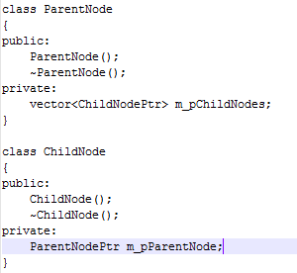
3.1) Circular dependence
We use an example to illustrate this case, please refer to code and UML diagram below, parent node consists its child node by smart pointer, and childs node also keeps its parent node by smart pointer, it seems make sense, but this is the circular dependence and will due to memory leak, so the better solution is that keep the parent ID in child node.
ParentNode
ChildNode

Slide 5
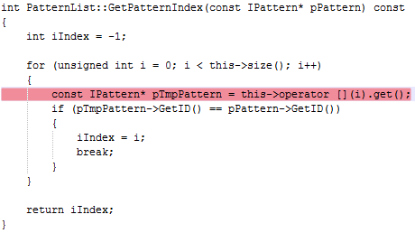
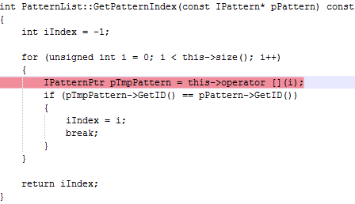
3.2) Performance issue
Smart pointer is a sword with two sides, it can help us to release memory on heap automatically, but it also needs some expenses about performance. Please refer to two code pieces below and notice the red line, this code will find the index of the pattern in the vector, if the pattern count in vector is very large, the code on the left is preferred because it used row pointer rather than the smart pointer on the right, and it reduced the expense for reference count.

Slide 6
4) Summary
We list some cases which need to use smart pointer and some other need raw pointer. Anyway, the principle is that we need to be clear about the life cycle of the object.
Cases need to use shared smart pointer
Num | Case Description
1 | Parent object will consist child objects by smart pointer, e.g. part object will consist cut features. As described in section 3.1.
2 | The object A will be transferred to function or class B, and function or class B will change object A.
…

Slide 7
Cases need to use raw pointer
Num | Case Description
1 | The object A will be transferred to function or class B, but function or class B will NOT change object A.
2 | The object will be used inside a function, as described in section 3.2.
…

